Slide 1
Heavy Photon Search at JLab
Bradley Yale

Slide 2
Outline
Motivation for the Heavy Photon (A’)
A’ Production and kinematics
HPS Experimental Setup
Simulation and Analysis Software

Slide 3
What is a heavy photon?
NOT a Standard Model photon!
A new massive U(1) gauge boson from a hidden sector (‘dark’ photon)
Couples to new, appropriately charged matter and also to the SM through kinetic mixing with the photon
Would serve as a ‘portal’ to a hidden sector beyond the Standard Model

Slide 4
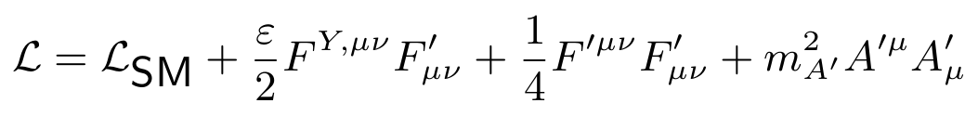
Primary Motivation:
Natural Extension to the SM
The A’ bridges hidden sectors to the SM through kinetic mixing with the photon
It acquires mass through symmetry breaking
Hidden sectors assumed to be ‘Higgsed’ (all gauge bosons have acquired mass)

Slide 5
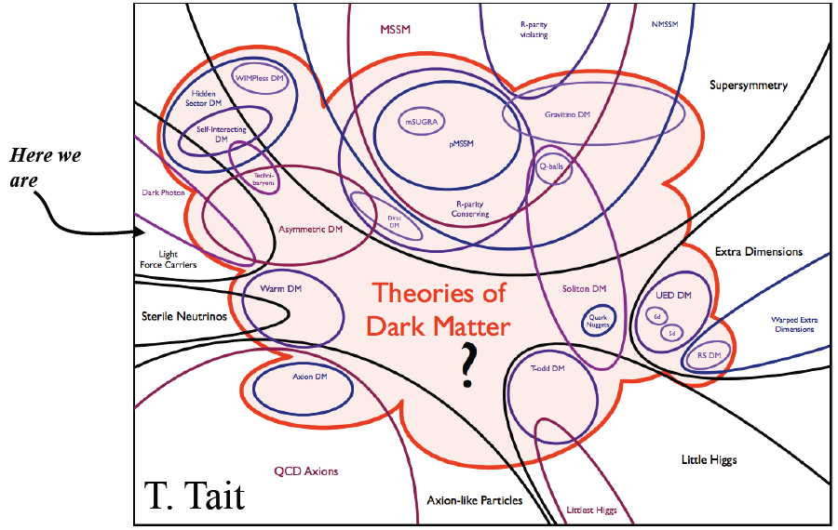
Disclaimer: A’ and DM do NOT imply each other’s existence!

Slide 6
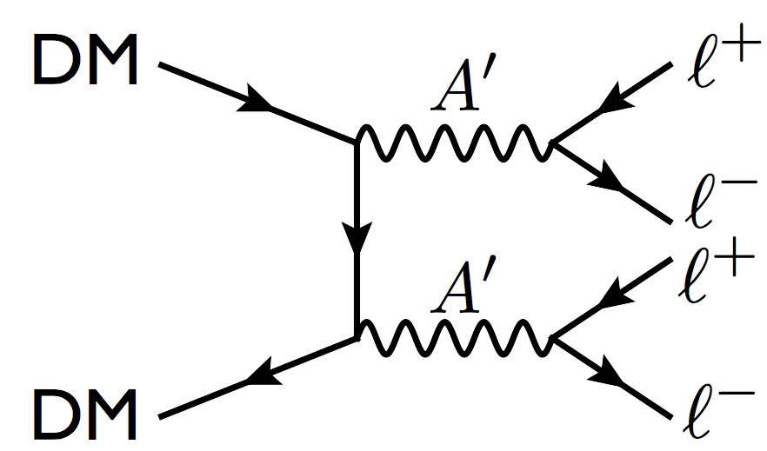

Cosmological Evidence?
Excess of positrons in cosmic rays =>Annihilation of DM particles? (INTEGRAL, PAMELA, HEAT)
No excess of antiprotons possibly hints at an upper limit on the A’ mass $m_{A′}<2m_{p}$ => $m_{A′}$~MeV-GeV?

Slide 7
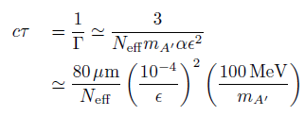
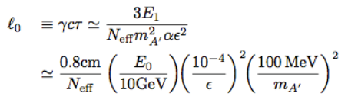

A’ Decay
Unlike the SM photon, the A’ has an appreciable lifetime due to its weak coupling to EM (~1/$ε^{2}$) and mass

Slide 8
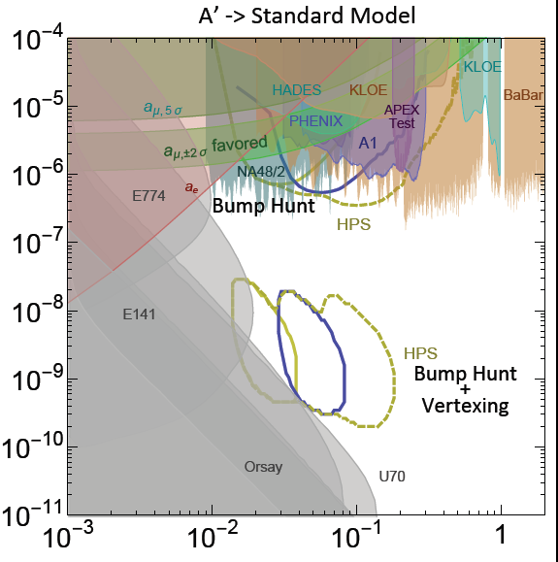


Mass-Coupling Parameter Space
Theoretical,
experimental, and
technological
constraints offer a
suggested window
in which medium-
energy experiments
like HPS should
search for the A’
(NOT exhaustive!)

Slide 9
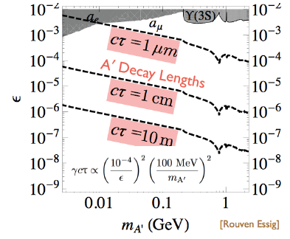
A’ Decay
Small coupling, intermediate mass range

Slide 10
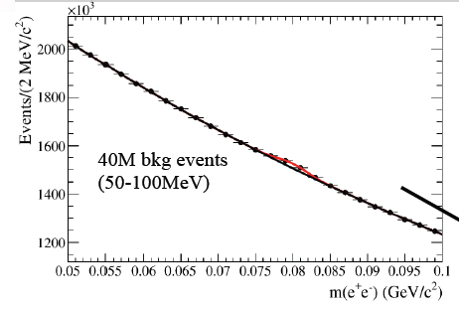

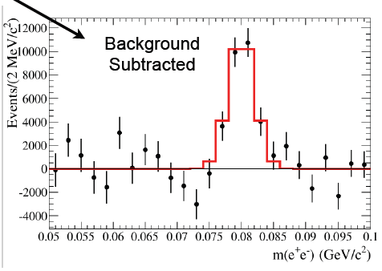
Bump Hunt (large Coupling)

Slide 11
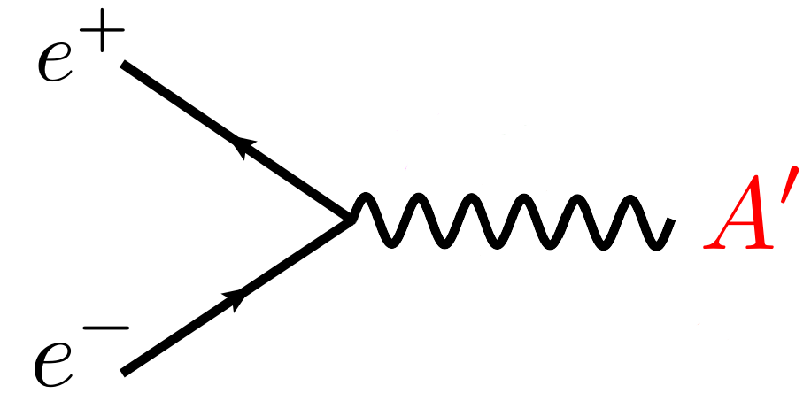
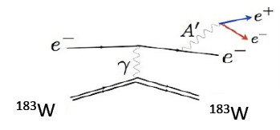
A’ Production & Kinematics
The A’ can be produced by a process analogous to bremsstrahlung, inherited through its coupling to EM
εe

Slide 12
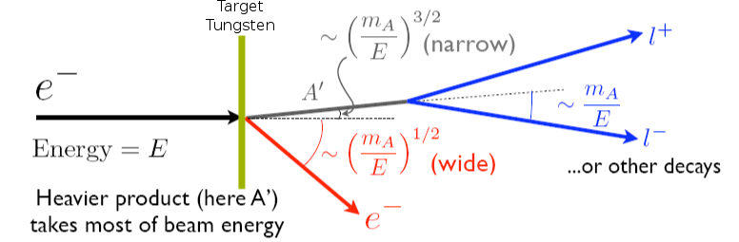
A’ Production & Kinematics
The A’, like Bremsstrahlung photons, is produced at very forward angles

Slide 13
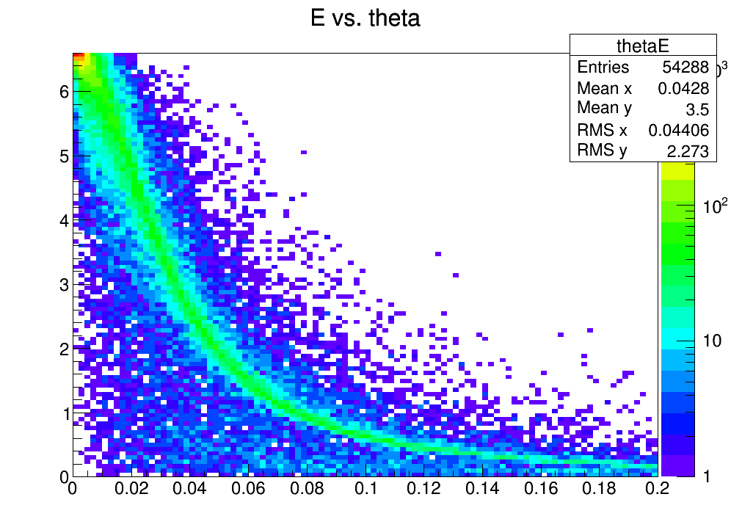
A’ Production & Kinematics

Slide 14
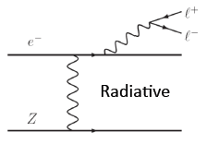
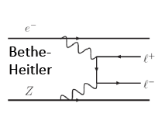
QED Background
Multiple Coulomb scattered electrons from target, and ‘tridents’

Slide 15
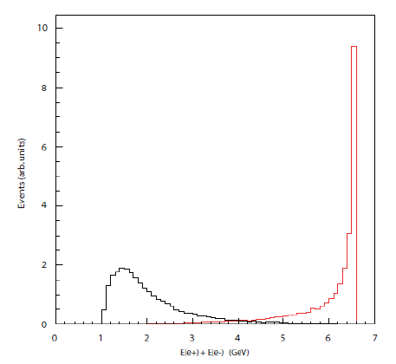
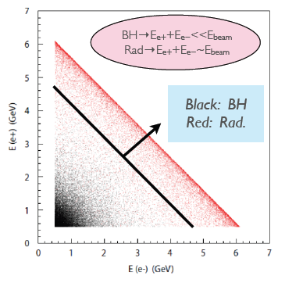
Trident Background
Signal only located in ‘radiative’ regime
BH dominates (~100x) but peaks at low x

Slide 16
A’ Search Summary
A narrow resonance in the e+e- invariant mass spectrum and displaced vertex relative to the target are the signatures to search for
All trident photons will decay promptly at the target. This will be key in eliminating the background
Excellent mass and vertex resolution is needed for the experiment

Slide 17
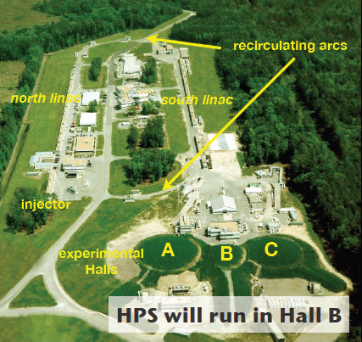
HPS Setup in Hall B at Jlab

Slide 18
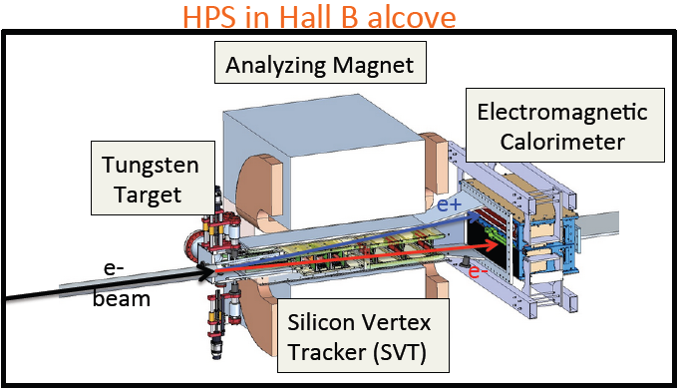
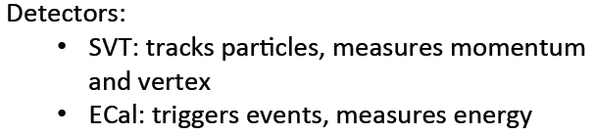


Slide 19
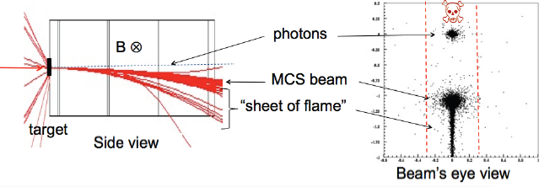
Electron Beam and Sheet of Flame
E-beam pulsed in 2ns bunches
The analyzing magnet bends the electrons into a ‘sheet of flame’ which the electronics must avoid

Slide 20
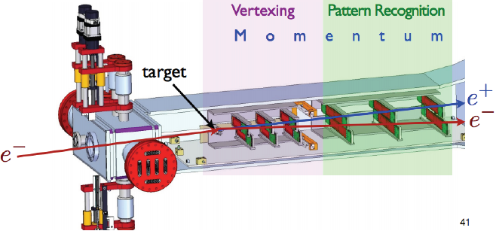
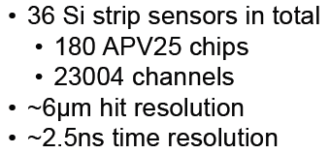
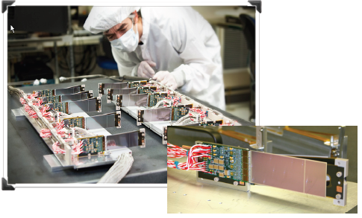
Silicon Vertex Tracker (SVT)
Each channel has preamp + shaper
Pulse shape 35ns
Shaper sampled at 40MHz
Fit pulse to find hit time and position

Slide 21
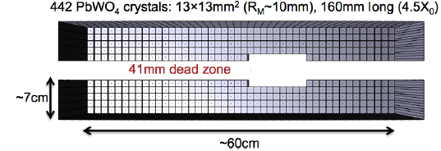
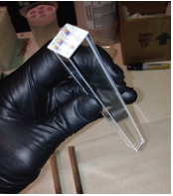
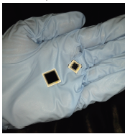

Electromagnetic Calorimeter (ECal)
Data recorded with 250MHz 12 bit FADCs
Energy and time of hit sent every 32ns to trigger processor (FPGA)
Trigger records a hit as a candidate hit when conditions are met
Sophisticated clustering algorithms help decide when to trigger

Slide 22
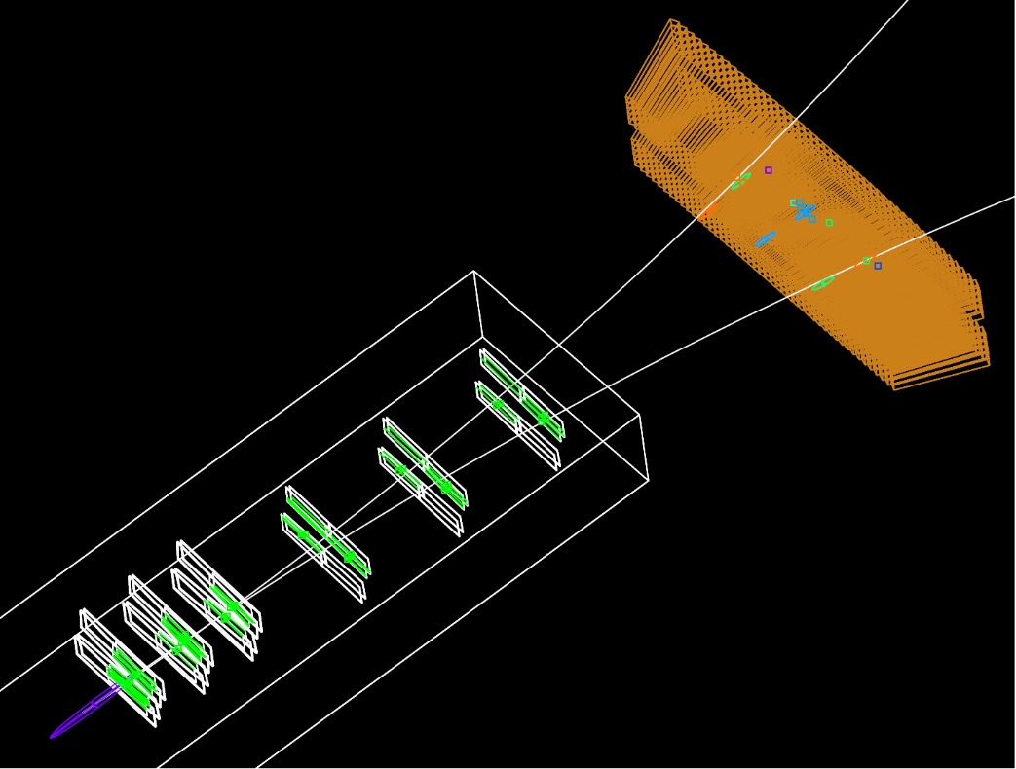
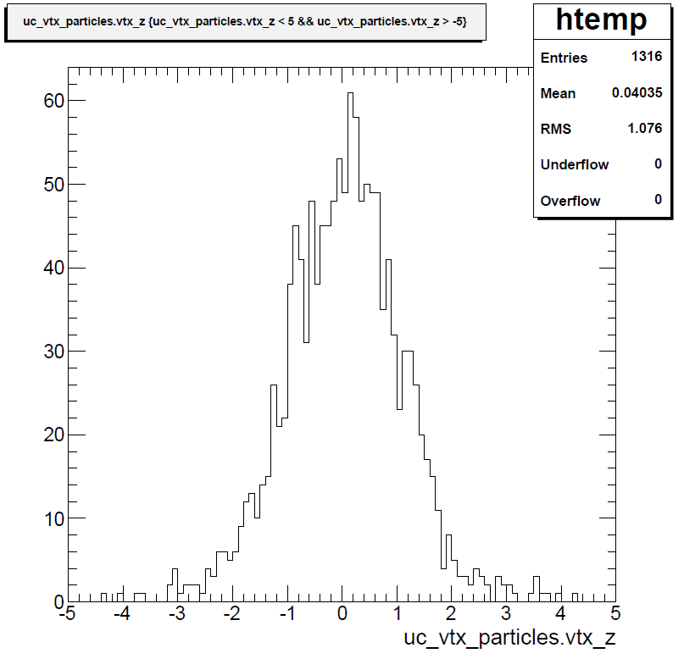
Analysis Tools (JAS3, ROOT)

Slide 23
Engineering Run 2015
Great success! SVT finally took data at its closest proximity to beam (0.5mm)
69 Million events, 16kHz pair triggers
>3x more tracks than before
Plenty of data to analyze already!

Slide 24
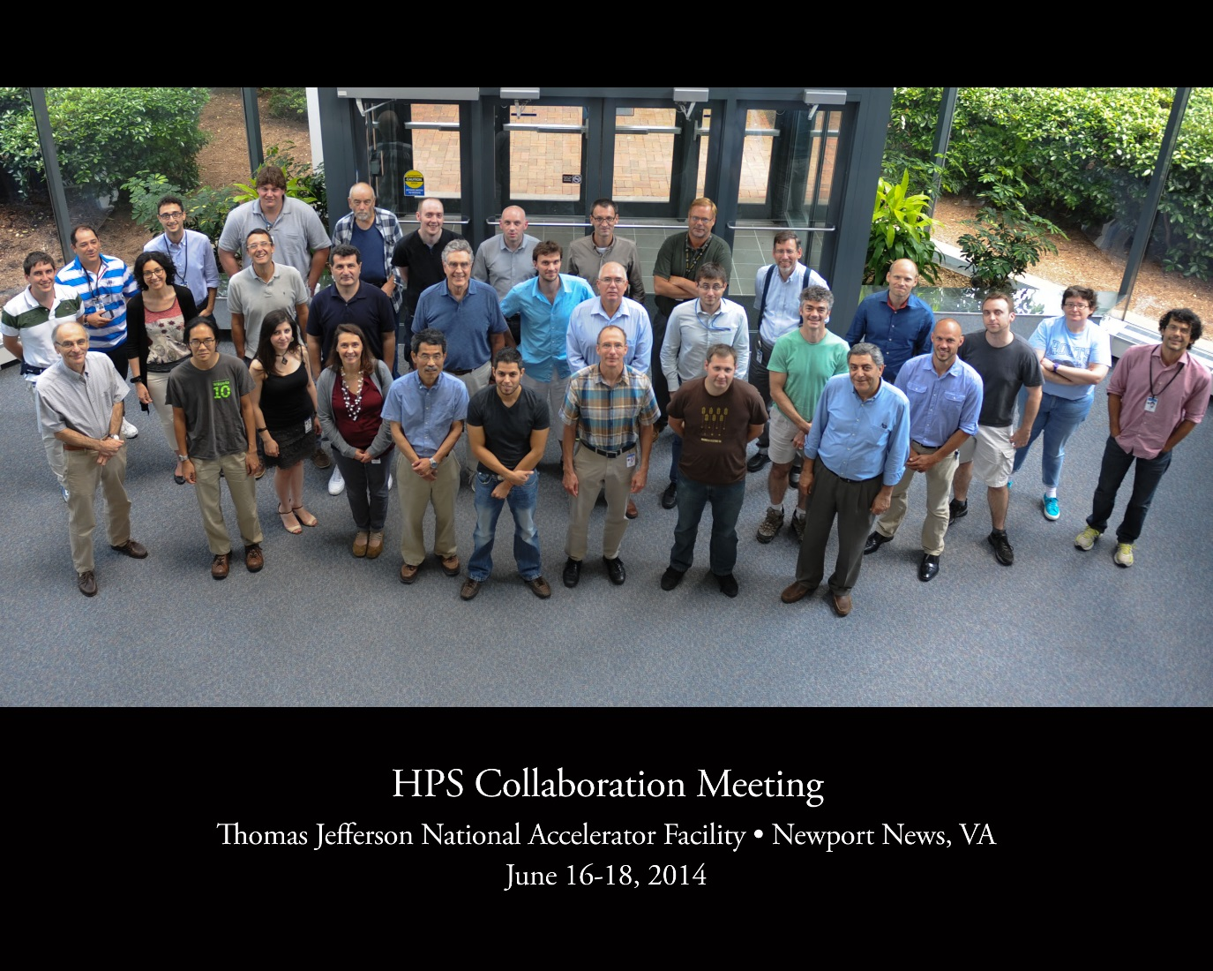
Thank you!

Slide 25
Additional Slides
Decay from kinetic mixing
Effective photon flux
Cutoff energy/angle
Background reduction
Energy slope cut

Slide 26
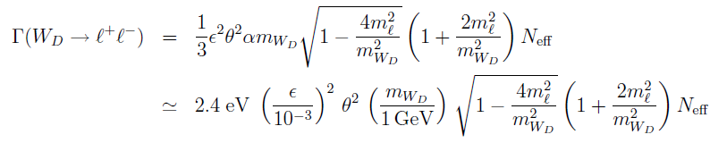


Decay from kinetic mixing
Assumption: All gauge bosons have some mixing angle θ with ${U(1)}_{D}$

Slide 27



χ (effective photon flux)
Dominated by elastic form factor

Slide 28






A’ Production & Kinematics
When calculating
Put the Mandelstam variables in terms of
f
=>

Slide 29





A’ Production & Kinematics
Weizsäcker-Williams Applied to the A’
Integrate over angles
Integrate over x (one) cutoff energy
=>

Slide 30




A’ Production & Kinematics
The approximation also breaks down at
=> (other cutoff energy)
So the median energy is
Characteristic opening angle:
=>

Slide 31

Strategies to reduce
Bethe-Heitler background
B-H tridents are peaked at small x, unlike the A’
=> Require 1- x >
Peaked at small $θ$ like the A’
=>Probably shouldn’t restrict $θ_{A′}^{min}$
=> Focus on the recoiling electron (difficult!)
$E_{R}\sim { m}_{A′} θ_{R}\sim {\left(\frac{m_{A′}}{E}\right)}^{1/2}$

Slide 32
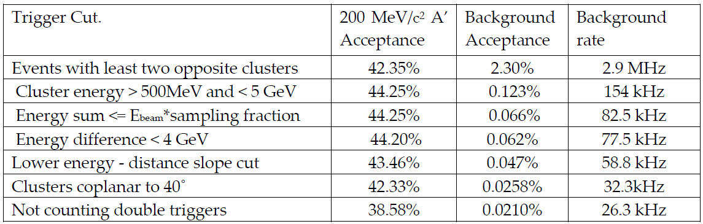
Trigger Cuts
Background acceptance must accommodate max trigger rate of 50kHz

Slide 33
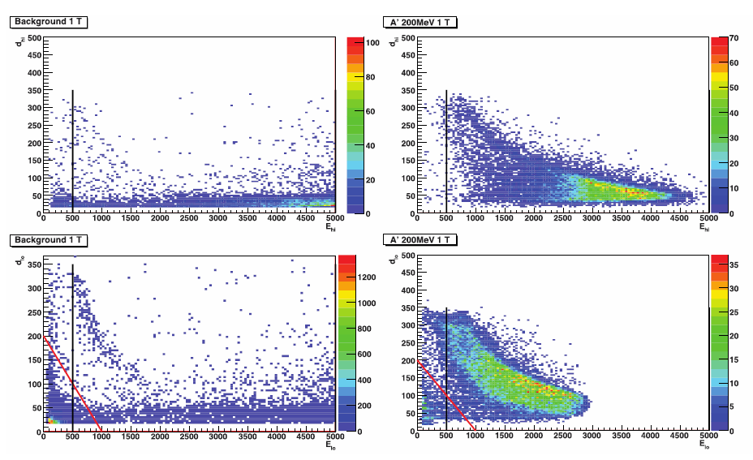
Energy-Distance Slope Cut

